Slide 1
Mobile Robot
Path Drift Estimation using Visual Streams
Helio Perroni Filho
Ohya group (i-ROBOT)
Notes:
Hello everyone, I'm Helio Perroni Filho and this is my presentation on Path Drift Estimation for Mobile Robots using Visual Streams.

Slide 2
Teach-Replay for Robot Navigation
Teaching a robot to move along a route by example
Simpler than programming, can be done by untrained operator
Guide
Teach step
(Robot is guided over path)
1.
Robot
Start
Finish
2.
Replay step
(Autonomous motion)
Robot
Notes:
Currently there is great interest in more intuitive man-machine interfaces for robotics systems, especially robots that can be configured by example, rather than direct programming. The appeal is that robots can then be configured by unskilled operators. This s called teach-replay.
For example, let's say we have an office courier robot to carry documents or supplies from one room to another. If our robot can do teach-replay, first we guide it through the route (what we call the “teach step”),and later, using information gathered along the route, the robot will retrace it autonomously (the “replay step”).

Slide 3
Teach-Replay for Robot Navigation
Visual teach-replay: appearance-based navigation
Cameras have a number of advantages:
  Cost-effective
  Robust
  Ubiquitous (they're everywhere)
  Intuitive to humans
Image
(replay step)
Landmark
Replay path
Route
correction
Image
(teach step)
drift
Teach path
Notes:
A lot of work has been done on teach-replay, especially using cameras as sensors. Cameras have many advantages over other kinds of sensors: they are compact, accurate, cheap and ubiquitous.
Work in visual teach-replay navigation has often focused on appearance-based navigation, which uses differences in the appearance of selected landmarks to estimate differences in robot location between teach and replay paths, and effect corrections if necessary.

Slide 4
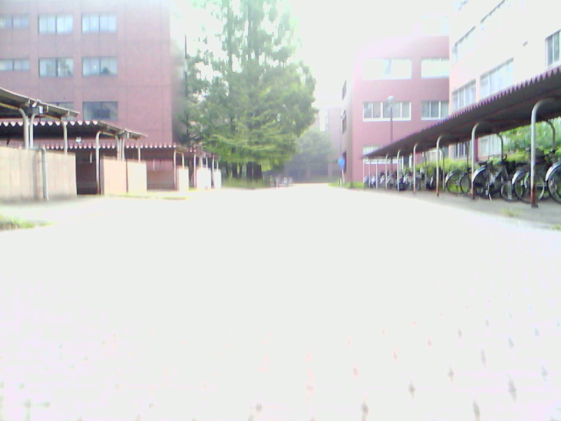
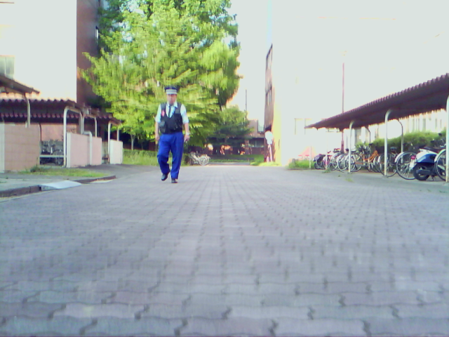
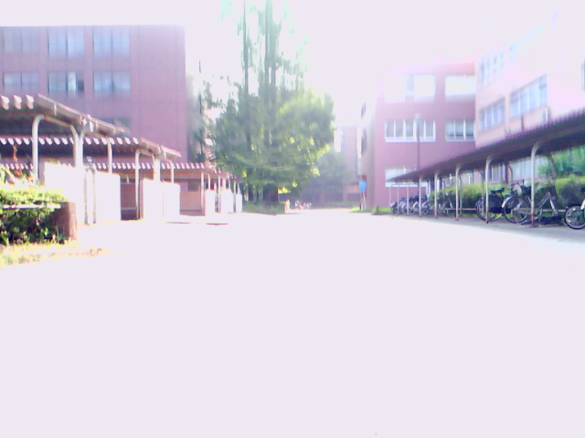
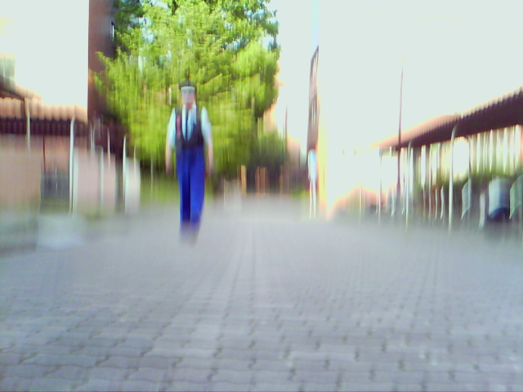
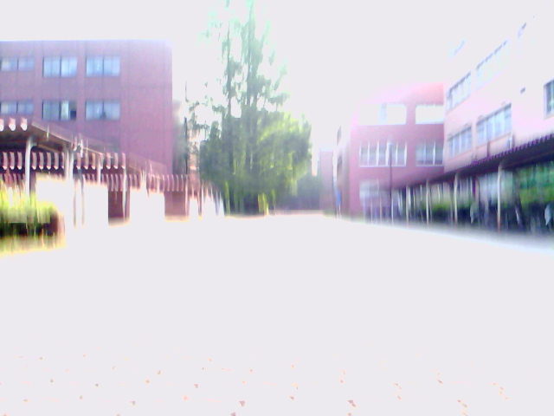
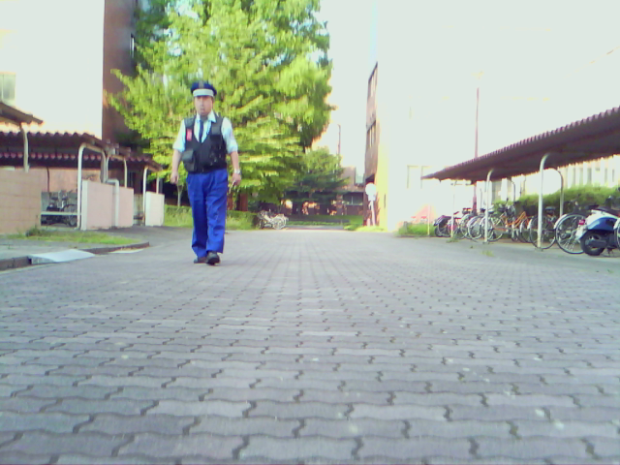
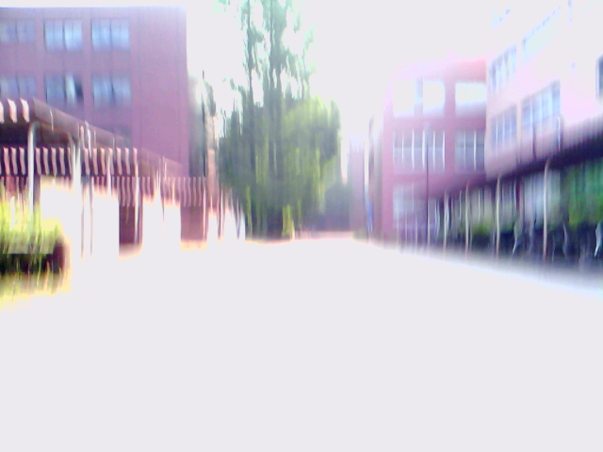
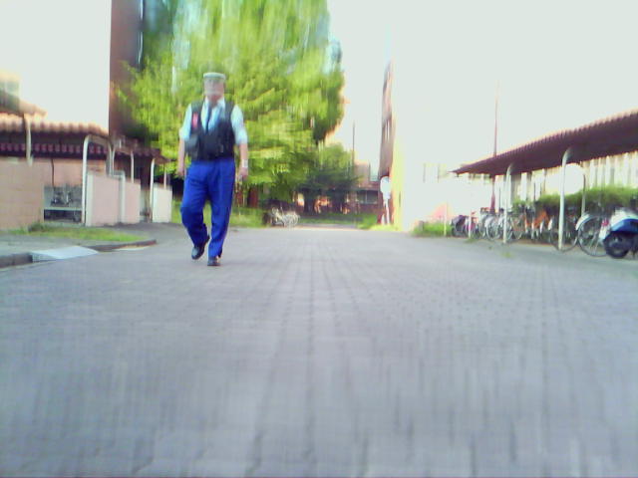
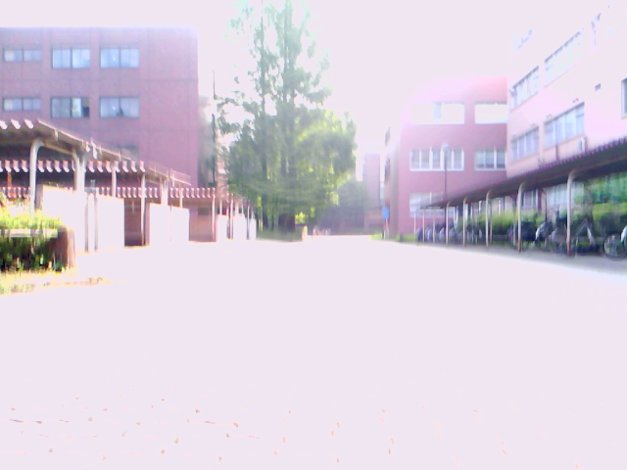
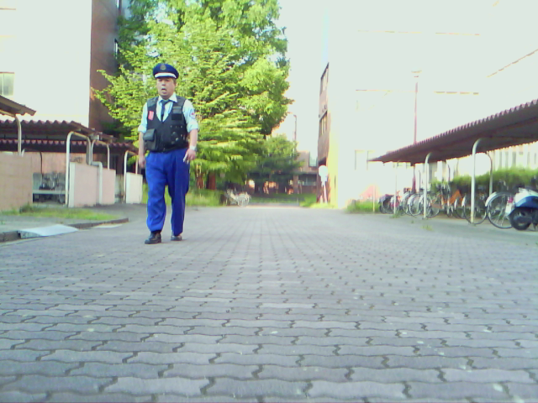
Teach-Replay for Robot Navigation
How to recognize the same landscape across changes in lighting, occlusions, moving elements, etc?
Teach step
Replay step
Need to find and/or compute invariants
Notes:
But extracting physical location from images can be tricky. As can be seen here, lighting changes, occlusion, and the presence of moving elements such as pedestrians can completely change how a landscape looks. It is therefore necessary to find or compute invariants, features that are common to images of a given landscape, despite whatever variations the actual images are subject to.

Slide 5
Teach-Replay for Robot Navigation
Method | Ref. | Sensrors | Environments | Variations
 |  |  |  | Lighting conditions | Occlusion | Moving Elements
Correspondence of vertical lines | [9] | Monocular camera | Indoors | No | No | No
Template matching | [10] | Monocular camera | Indoors | No | No | No
Average Landmark Vector | [11] | 360° panoramic camera, polarized light sensor | Simulated, Outdoors | Yes | No | No
Block-matching Optional Flow | [12] | 360° panoramic camera, odometer | Indoors | Yes | Yes | No
Feature point tracking | [13] | Monocular camera | Indoors, Outdoors | Yes | No | Yes
Mutual Information Optical flow vectors | [14] | Monocular camera | Indoors | No | No | No
Visual motion estimation with stereo matching | [15] | Stereo camera | Indoors | Yes | Yes | Yes
Local best match and sequence recognition | [16] | Monocular camera | Outdoors | Yes | Yes | Yes
Differential Visual Streams (DiVS) |  | Monocular camera | Indoors, Outdoors | Yes | Yes | Yes
Notes:
Finding invariants that always apply can be tricky, though. Here I show some of the methods that have been proposed over the years – you can find the respective articles on my report's bibliography, these are their reference numbers.
Most of these methods deal with computing a representation that is consistent across image variations, but fall short one way or another. A common limitation is for a method to only work indoors or outdoors. Difficulties on dealing with moving elements, such as people, or occlusions are also common. Some methods also require non-standard hardware, such as stereo cameras.
Therefore, there is still demand for a teach-replay method that works well indoors and outdoors, uses simple hardware such as a single monocular camera, and can deal with changes in lighting and the presence of occlusion and moving objects.

Slide 6
Teach-Replay for Robot Navigation
My approach: Differential Visual Streams (DiVS)
Features:
  Stable representations from image sequences
  Requires single, uncalibrated monocular camera
  Robust to lighting changes, occlusion, moving objects
  Applicable indoors and outdoors
  Fast processing, convenient for real-time use
  Basis to implement teach-replay on visual input
Notes:
The limitations of current visual teach-replay methods have motivated me to look for a new solution, which I call Differential Visual Streams, or “DiVS” for short.
It works on image sequences, generating stable representations that are robust to changes in lighting, occlusions and the presence of moving elements. It is applicable to indoors and outdoors environments, requiring a single, uncalibrated monocular camera as input. Last but not least, it is fast to compute, being convenient for real-time operation.
Therefore, DiVS provides a sound base for the implementation of teach-replay on visual input.

Slide 7
Topics
Teach-Replay for Robot Navigation
Differential Visual Streams (DiVS)
Control Model
Experiments
Conclusions
Notes:
The DiVS method and its application to teach-replay are the subjects of the remainder of this presentation.
In the next section I describe the DiVS method. Then I show how it can be used to implement a teach-replay control module for a mobile robot.
Next I show the results of a number of experiments made with the control module, what conclusions can be drawn from those results, and discuss directions for further research.

Slide 8
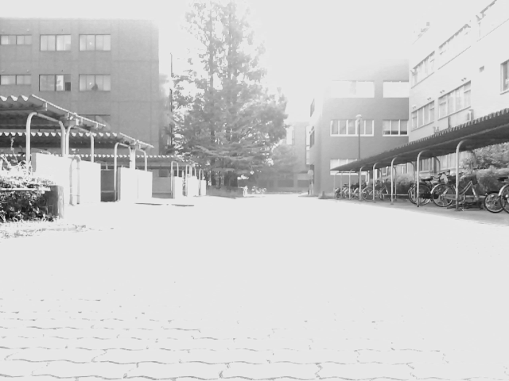
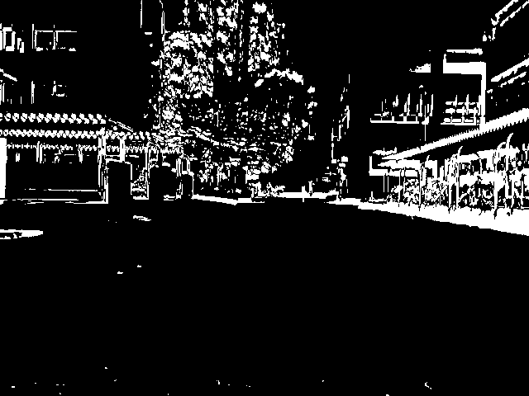
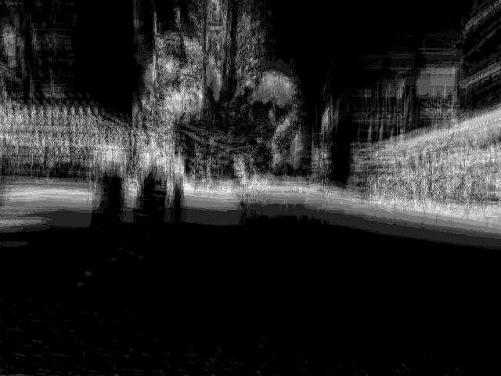
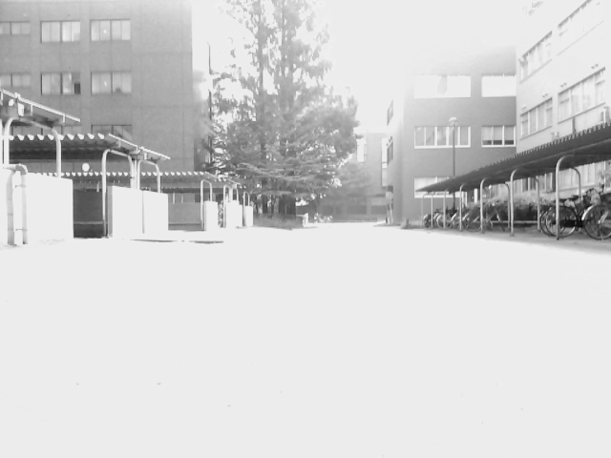
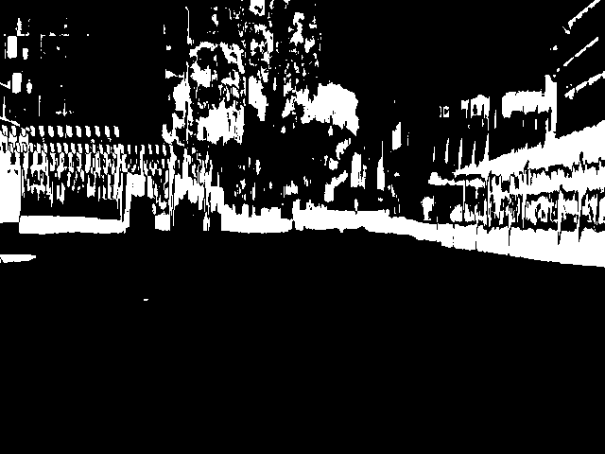
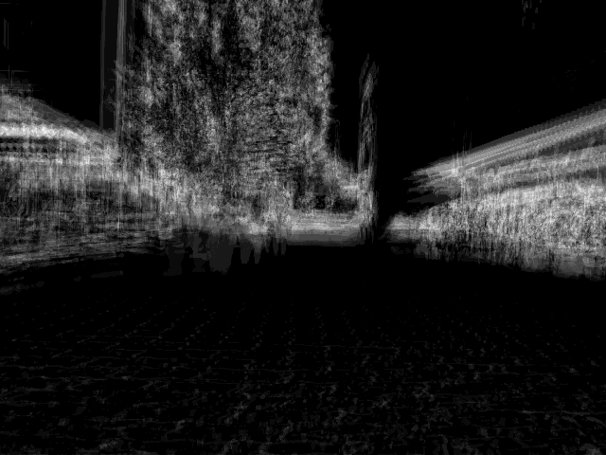
Differential Visual Streams (DiVS)
Converts an image sequence into differential images robust to lighting changes, occlusion and moving elements
Grayscale images
Thresholded difference images
(lighting invariant)
Average over w difference images
(movement / occlusion invariant)
…
…
…
I1, ..., Ik, ..., It
Bk = OTSU(|Ik-1 - Ik|)
Notes:
Given a sequence of gray-scale images, the changes between successive images can be represented by the pixel-by-pixel absolute differences between them. The darker regions of such difference images show where the two images are very similar to each other, and the brighter regions, where they are different. This separation between “change” and “no change” regions can be enhanced by the application of a thresholding operation, such as Otsu's method.
These thresholded difference images provide representations stable to lighting changes, but they are still affected by occlusions and moving elements. In order to account for that, we smooth out such transient changes by calculating the average over a sequence of difference images.
These are what I call differential images, they show the amount of change in different regions of the visual field over a sequence window of some size w. Brighter pixels show high amounts of change, and darker ones, low amounts.

Slide 9
Topics
Teach-Replay for Robot Navigation
Differential Visual Streams (DiVS)
Control Model
Experiments
Conclusions
Notes:
So DiVS provides a representation that is robust to changes in lighting, occlusion and moving elements. How can it be leveraged to implement teach-replay navigation?

Slide 10
Control Model
Robot drift is accompanied by shift in landmark images
Front View
(camera image)
Top View
Landmark
Teach
Robot
Replay
drift
Δy < 0
Δθ < 0
shift
(pixels)
p < 0
Notes:
First we need to know how changes in observer location are related to visual input.
Let be a teach step in a very simple environment, with a single landmark placed right in front of the robot. In this case the landmark's image will fall on the center of the robot's visual field.
Later in the replay step, if the robot is drifting to the right, the landmark's image will fall on the left side of its visual field. We call this difference in apparent position the landmark's shift: it is measured relative from the landmark's original (apparent) position, and therefore can have negative or positive values.
This relation between physical drift and image shift can be explored to enable robot localization.

Slide 11
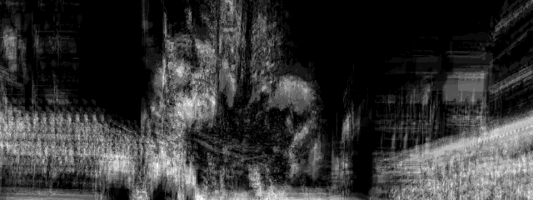
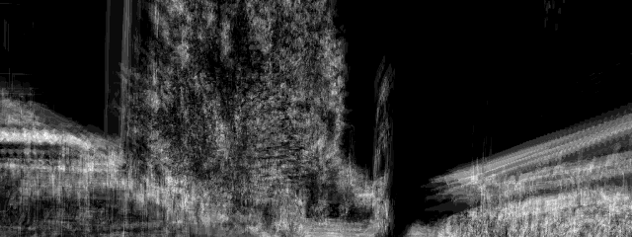
Control Model
Differential images can be compared for shift
teach
teach
shift p < 0
replay
replay
Remove bottom half
(poor signal / noise)
Match images by cross-correlation
Notes:
DiVS images can be compared for shift. In this example we compare a DiVS image from a teach step to another from a replay step.
First, notice that the bottom half of DiVS images is usually of poor recognition value. Because it mostly pictures the ground, it is either largely empty, or filled with noisy patterns such as those left by floor tiles. Therefore, before trying to compare DiVS images, we do away with their lower halves, keeping only the upper halves for comparison.
Then we look for the best match between the teach and replay half-images using cross-correlation. The position of best match indicates the shift between teach and replay DiVS images. As shown before, shifts are measured in pixels, can be either negative or positive. Negative shifts indicate drifts to the right, and positive shifts, drifts to the left.
Incidentally in this example the shift is negative, indicating a drift to the right.

Slide 12
Control Model
Image shift is converted to a control signal to correct drift
Front View
(camera image)
Top View
Landmark
Teach
∂k
∂
...
∂
k+1
t
Teach
shift calculation
Robot
∂'k
∂'
...
∂'
Replay
k+1
t
Replay
Shifts
pk
pk+1
pt
x
shift
(pixels)
pk < 0
y
YPSpur_line(CS_FS, dx, -dy*pk, -dr*pk)
Notes:
Given two DiVS image sequences from a teach step and a replay step, shifts can be computed from successive image pairs. DiVS images from the teach and replay steps are paired by index; odometry is not used, but it is assumed that both steps were recorded at the same speed.
These shift values can then be used to control the robot over time.
Empirical tests suggest a linear relation to image shifts and drifts in distance from the original path and heading direction. Therefore, in our control model we convert image shifts, which are given in pixels, to drift estimates merely by applying conversion factors as shown here.
(dx, dy, dr) are system parameters, we'll come back to them when we talk about experiments.

Slide 13
Topics
Teach-Replay for Robot Navigation
Appearance-based Navigation
Differential Visual Streams (DiVS)
Control Model
Experiments
Conclusions
Notes:
How well does the method described so far work?

Slide 14
Experiments
System parameters
  Linear speed v = 0.3m/s
  Snapshot size 640x320, frequency 6.7Hz (one picture / 0.15s)
  DiVS image window w = 25 pictures
  Control factors (dx, dy, dr) = (0.3m, 0.002m, 0.2°)
Record odometry as approximation to true paths
Teach paths
  Several records at each environment, from same start pose
  Initial in-place turn 0° ~ 10° left or right
  Set off in straight path, stop after running for 10m
Notes:
All field test procedures were performed under the same system parameters as shown here.
During teach and replay steps I record odometry to provide an approximation for the robot's true location. Despite its limitations it is good enough for the scale of these tests.
Teach step paths were just straight paths from the start point, with a length of 10 meters. Several teach paths were recorded. Starting from a common initial pose, the robot would make an initial in-place turn of up to 10°, and then set off in a straight line.

Slide 15
Experiments
Teach / Teach tests
  Compare two teach step records
  Check quality of computed image shifts
  Off-line
Reference record
Test records
5°
0°
-5°
Early morning 07/24 07:30~
No moving elements
Late afternoon 07/30 16:15~
Occasional moving elements
(pedestrians, cyclists)
Notes:
First, in order to check if image shift values were consistent across different amounts of drift and visual conditions, several teach steps were recorded and compared off-line.
The reference teach step was recorded in the morning, in the absence of any moving elements. The test records were recorded in the afternoon, and occasionally contain moving elements such as pedestrians.
Two of the test records differed from the reference by an initial in-place turn of 5°, either to the left or to the right.

Slide 16
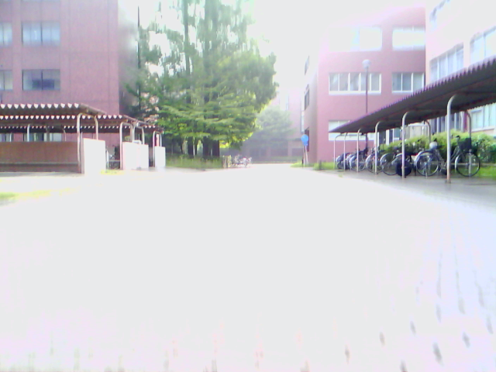
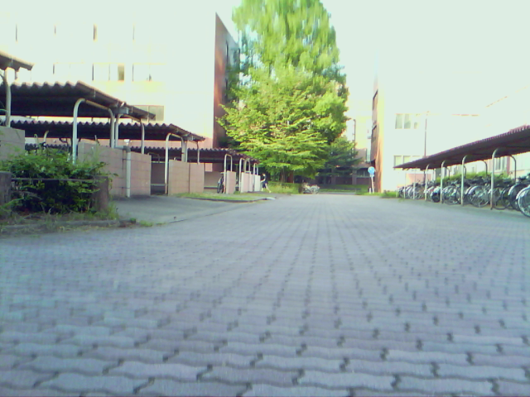
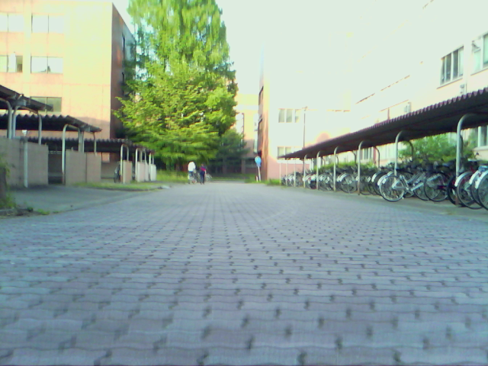
Experiments
Teach / Teach tests
Test record 0°
Same direction as reference
Lighting changes
Occlusion
Moving element
Reference record
Test record 5°
Test record -5°
Early morning 07/24 07:30~
No moving elements
Changes in direction from reference
Lighting changes
Notes:
The reference and test records are as shown here. There is a great deal of saturation in all images, due to limitations in camera hardware. Large lighting differences exist between reference and test records. Also in the 0° case, a campus officer walking towards the robot adds movement to the scene, as well as partially occlude the scene.

Slide 17
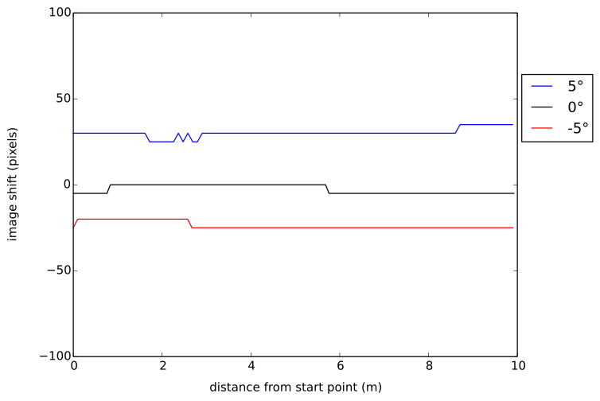
Experiments
Good results: right direction, consistent values
Processing time per DiVS image: 0.04s in 2.67GHz Core i5
Notes:
Despite the differences in visual conditions and the presence of a moving element for much of the test record, the computed shifts for the 0° case either zero or negligible, correctly indicating the robot is treading much the same path as in the reference record.
Results were very good for the 5° drift cases too: shift direction agrees with drift's, and numerical values are consistent.
By the way, the time my implementation took to generate a single DiVS image on my lab notebook was 0.04 seconds on average.

Slide 18
Experiments
Teach / Replay tests
  Initial in-place turn 0° ~ 10° left or right, to simulate drift
  Start from same point as teach path, go straight ahead
  Calculate shift, issue drive command every 4s
Teach step
Replay steps
5°
2°
-2°
-5°
Early morning 07/24 07:30~
No moving elements
Early morning 07/24 07:30~
Occasional moving elements
(pedestrians, cyclists)
Notes:
So shift calculations are go, how well do they translate to robot steering?
To test the control module, the robot was set off at straight paths diverging from the original teach path by an initial in-place turn of 2° or 5°, either left or right.
The robot records images as it goes, and as soon as it has enough to calculate a DiVS image, it computes shift between it and the corresponding teach DiVS image, steering in response to any non-zero shifts found.

Slide 19
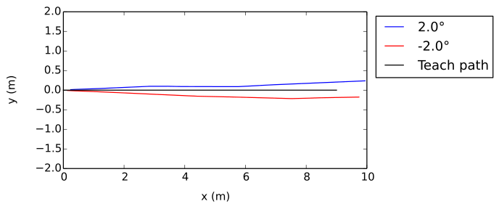
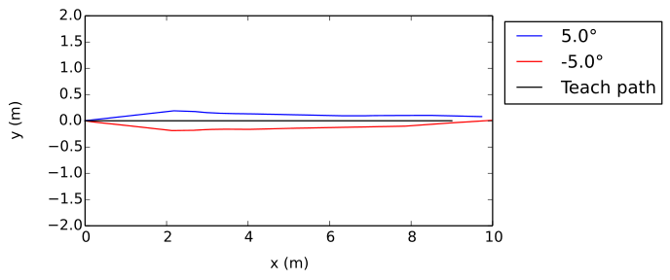
Experiments
Mixed results: didn't get back to teach path, but was never very far from it either
Good results: steady convergence to teach path
Notes:
These plots compare the teach step path with two replay paths, starting from initial in-place turns of 2° or 5°, either left and right.
In each plot, the black line shows the teach path, which is a simple straight path. The blue and red lines represent the replay paths from left drift and right drift respectively.
Teach / replay results were mixed. For 2° drift, in the left case, after an initial route correction in the right direction, the robot settles in a path parallel to the teach step's, but eventually deviates from it. For the right drift case, it takes a long time to recognize the drift; it does start converging towards the teach path then, but too slowly.
For 5° drifts, results were much better, with the robot eventually returning to the teach path.

Slide 20
Topics
Teach-Replay for Robot Navigation
Differential Visual Streams (DiVS)
Control Model
Experiments
Conclusions
Notes:
What conclusions do I get from these experiments, and where to go from here?

Slide 21
Conclusions
DiVS provides a visual representation robust to:
  Lighting changes
  Occlusion
  Moving Elements
DiVS image shift correlates well with route drift
  Sign of shift values indicates direction of drift
  Shift amount correlates (linearly?) with drift distance
  Teach-replay navigation over DiVS is possible

Slide 22
Conclusions
Further research
  Further field tests
  Evaluate method robustness
  Identify (un)favorable environments
  Larger-scale replay tests
  Image pairing
  More elaborate paths
  Control model

Slide 23
The End
Questions?
Notes:
This is the end of my presentation. Any questions?

Slide 24
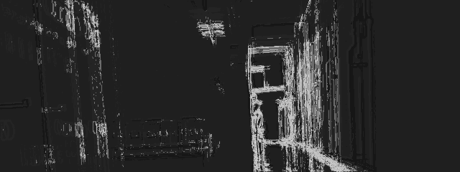
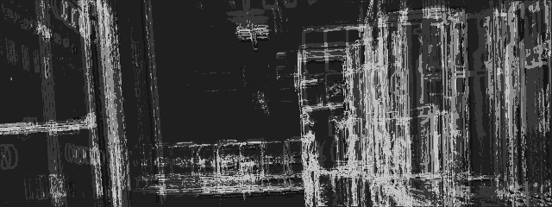
Curved path

Slide 25
Sideways drift
Problem: poor shift results when robot moves
parallel to teach path
Notes:
The main reason for these sub-optimal results is because differences in sideways position produce much less disparity in far-off landmarks, which compose the bulk of the landscape in many environments, especially outdoors. This results in much more subtle differences between DiVS images, and smaller, less definite shifts. So after an initial rout correction, if the robot happens to arrive at a path parallel to the teach step's, it becomes much harder to produce further route corrections from there.

Slide 26
DiVS buffering lag
I =
I0
I1
I2
...
Iw-1
Iw
Iw+1
...
It-w
...
It
B =
B1
B2
...
B
Bw
B
...
B
...
Bt
w-1
w+1
t-w
DiVS =
∂w
∂
...
∂
...
∂t
w+1
t-w
Notes:
Let's do a quick recap on the process so far:
Starting from an image sequence, or stream...
We calculate pair-wise, thresholded difference images...
And then average those binary images over a window of some size w.
The sequence of images calculated according to this procedure is what I call a Differential Visual Stream, or DiVS.

Slide 27
Visual Navigation Methods
Metric map-building (e.g. SLAM)
  Represent environment as single geometric map
  Locate robot within map
  Limitations in range due to error accumulation
Topological
  Represent environment as graph of “locations”
  Edges represent inter-location reachability parameters
Mapless
  No global environment representation

Slide 28
Case for uncalibrated camera methods
Calibration may not be available
  Teach step recorded from external source (e.g. handset)
Parameters may change due to operational wear etc.
  Recalibrating camera may be inconvenient or impossible
  E.g. heavy industry robot, Mars rovers
It's one less thing to do (YAGNI)

Slide 29
Limitations of Structure from Motion
Originally conceived to work off-line in batch mode
Sensible to image variations caused by vibration
Poor results for images recorded under forward motion
Outdated (see Bundle Adjustment - A Modern Synthesis)
If your only tool is a hammer, every problem looks like a nail

Slide 30
Definition of Machine Learning
“A computer program is said to learn from experience E with respect to some class of tasks T and performance measure P, if its performance at tasks in T, as measured by P, improves with experience E.”
– Tom Michael Mitchell, Machine Learning

